Slide 1
CHATBOAT
DEPLOYMENT WITH
IBM CLOUD WATSON
ASSISTANT
PRESENTED BY
MAKATHI.R

Slide 2

INTRODUCTION
﻿Chatbots are computer programs that simulate human conversation using artificial intelligence. They can be used for a variety of purposes, from customer service to sales and marketing.
﻿
﻿

Slide 3
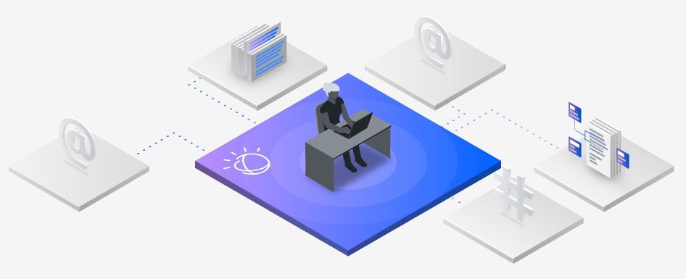
What does IBM Watson Assistant do?
﻿
Watson Assistant lets you build conversational interfaces into any application, device, or channel. Add a natural language interface to your application to automate interactions with your end users. Common applications include virtual agents and chat bots that can integrate and communicate on any channel or device.

Slide 4
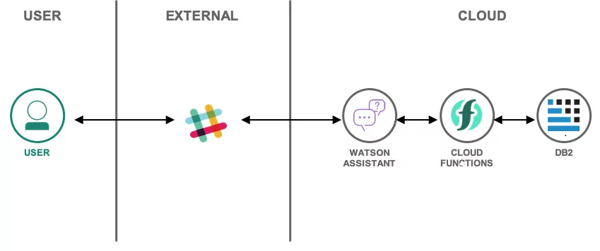

Slide 5
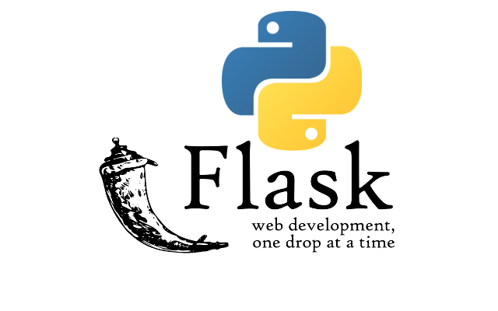
FLASK
Flask is a micro web framework written in Python. It is classified as a microframework because it does not require particular tools or libraries. It has no database abstraction layer, form validation, or any other components where pre-existing third-party libraries provide common functions

Slide 6
Flask in Python
﻿
Flask is a lightweight Python web framework that provides useful tools and features for creating web applications in the Python Language. It gives developers flexibility and is an accessible framework for new developers because you can build a web application quickly using only a single Python file.
﻿
Flask in cloud computing
﻿
Flask includes a built in development server and unit-testing support. It's fully Unicode-enabled, with RESTful request dispatching and WSGI compliance. Flask is useful for small, straightforward applications.

Slide 7
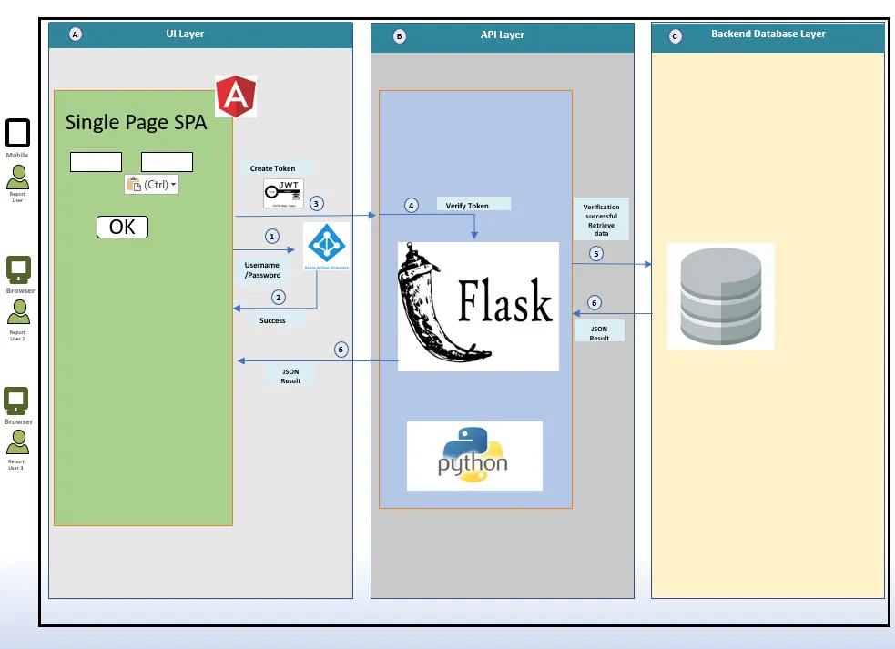

Slide 8
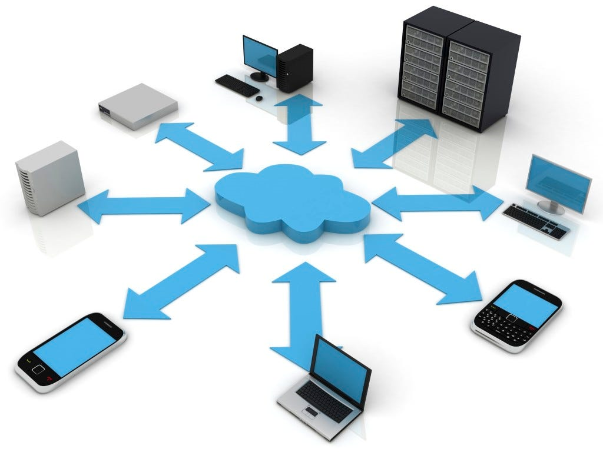
Advantages of using Flask
Flask is one of Python frameworks that had already gained wide popularity among web developers working with this programming language.
﻿
The primary advantages of choosing Flask are built-in fast debugger, secure cookies and unit testing support, Unicode basis, and more.

Slide 9
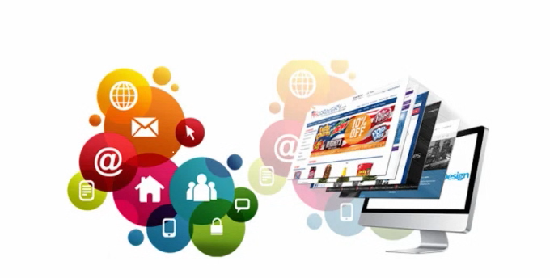
Disadvantages of Flask
﻿
Cons of Flask
Not suitable for big applications and projects.
It does not offer an in-built admin site for maintaining records for insertion, deletion, and modification.
Lack of Database and ORM.
Complex maintenance for large applications.
Libraries must be manually installed.
Limited community support and compare to Django.

Slide 10
CONCLUSION
﻿
Flask is a web framework, it's a Python module that lets you develop web applications easily.
It's a microframework that doesn't include an ORM (Object Relational Manager) or such features. It does have many cool features like url routing, template engine.
Flask is a web framework. This means flask provides you with tools, libraries and technologies that allow you to build a web application.
This web application can be some web pages, a blog, a wiki or go as big as a web-based calendar application or a commercial website.

Slide 11


